Slide 1
QUICK SORT

Slide 2
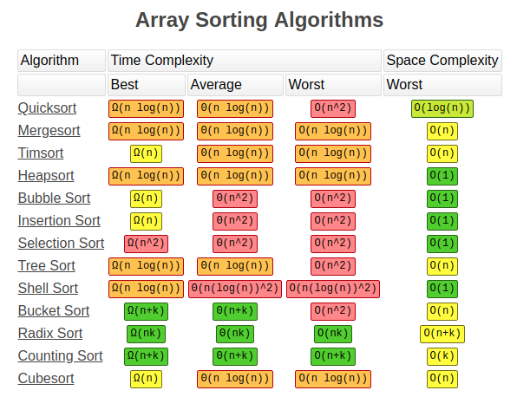
LOG 2 =0.30
LOG 3 =0.40

Slide 3
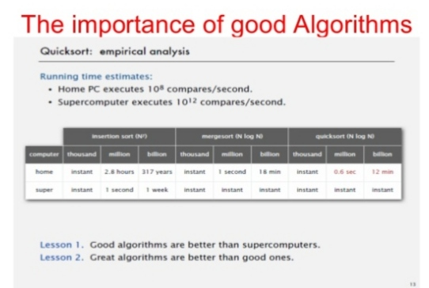
10 MILLION VS 100 BILLION

Slide 4
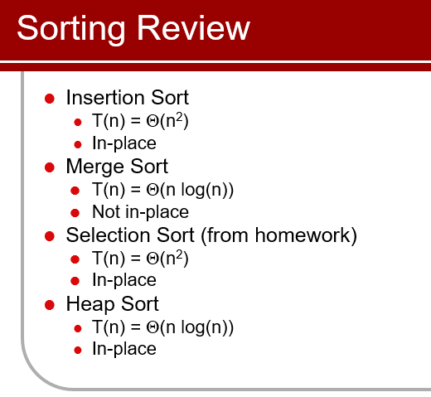

Slide 5
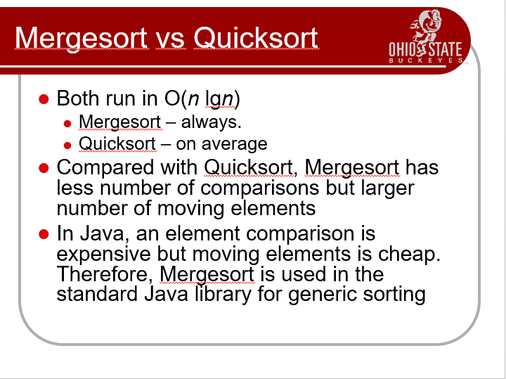

Slide 6
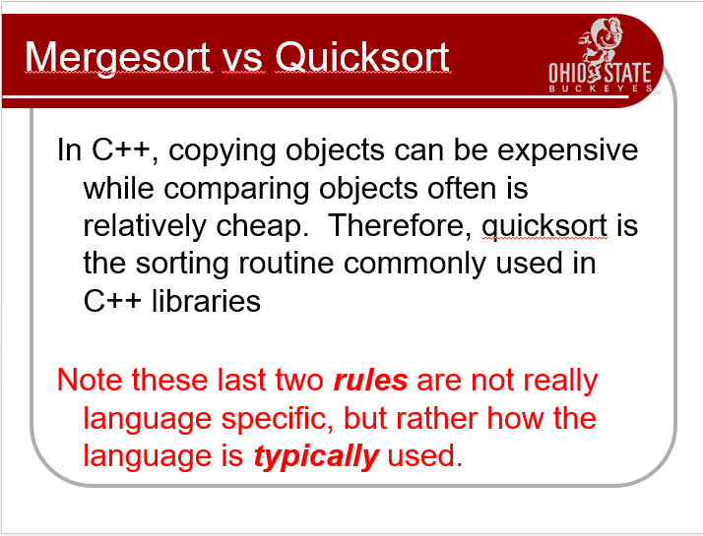

Slide 7
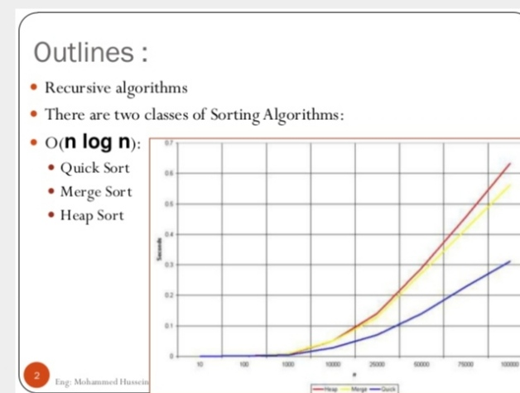

Slide 8
DIVIDE AND CONQUER
2
An algorithm is only called divide and conquer if it
contains two or more recursive calls
The divide and conquer strategy used to
make a more efficient search algorithm
can also be applied to sorting

Slide 9
DIVIDE AND CONQUER (CONT.)
3
Divide : Divide the problem P into P1 , P2,……Pk sub
problems until P is smaller one
Conquer : the sub-problems by solving them recursively
Combine : the solutions of sub problems to create a solution to the original problem

Slide 10
DIVIDE AND CONQUER (CONT.)
4
A problem size n
Sub problem 1 of size n/2
Sub problem 2 of size n/2
A solution to sub problem 1 |  |  | A solution to sub problem 2
A solution to the original problem

Slide 11
MERITS OF DIVIDE AND CONQUER
6
Time spent on executing the problem using divide and
conquer is smaller than others.
Provides efficient algorithm.
Suited for parallel computation in which each sub problem can be solved simultaneously by its own processor.

Slide 12
QUICK SORT

Slide 13

Sir Charles Antony Richard Hoare
Shell sort
Quick sort

Slide 14
In most cases Quick Sort is the best comparison sorting algorithm
Widely used as the sort funtion of many programming languages

Slide 15
Quick sort
The main idea is to partition the array into two regions:
 small items are moved to the left side of the array
 large items are moved to the right side
After partitioning, repeat the sort on the left and right sides
 each region is a sub-problem, a smaller version of the original problem

Slide 16
Quick sort
8
Main question: how do we decide which items are “small” and which are “large”?
A common technique: use the first item in the region as a
pivot
 everything less than the pivot ends up in the left region
items greater than or equal to the pivot go in the right
region

Slide 17
Pick a pivot
Use the first element as pivot
if the input is random, ok
if the input is presorted (or in reverse order)
all the elements go into S2 (or S1)
this happens consistently throughout the recursive calls
Results in O(n²) behavior (Analyze this case later)
Choose the pivot randomly
generally safe
random number generation can be expensive

Slide 18


This algorithm is the order of the array at a rate of ( n*log n), where n is the step number of the elements of the array ..
Meaning:
If we have a array of the element 128, this will sorted in steps of 896 ..
And this number is very appropriate when compared to other ranking algorithms
For example, in Bubble sort algorithm will need to step 16384 in any way ..

Slide 19

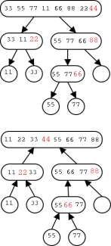
1. Best Case
Since each element ultimately ends up in the correct position, the algorithm correctly sorts. But how long does it take?.On this basis it is divided into following three cases.
Worst Case
Average Case
Best Case for Quick Sort
The best case for divide-and-conquer algorithms comes when we split the input as evenly as possible. Thus in the best case, each sub problem is of size n/2. The partition step on each sub problem is linear in its size. the total efficiency(time taken) in the best case is O(nlog2n). Worst Case for Quicksort
Suppose instead our pivot element splits the array as unequally as possible. Thus instead of n/2 elements in the smaller half, we get zero, meaning that the pivot element is the biggest or smallest element in the array.
The Average Case for Quicksort
Suppose we pick the pivot element at random in an array of n keys Half the time, the pivot element will be from the centre half of the sorted array. Whenever the pivot element is from positions n/4 to 3n/4, the larger remaining sub-array contains at most 3n/4 elements.

Slide 20

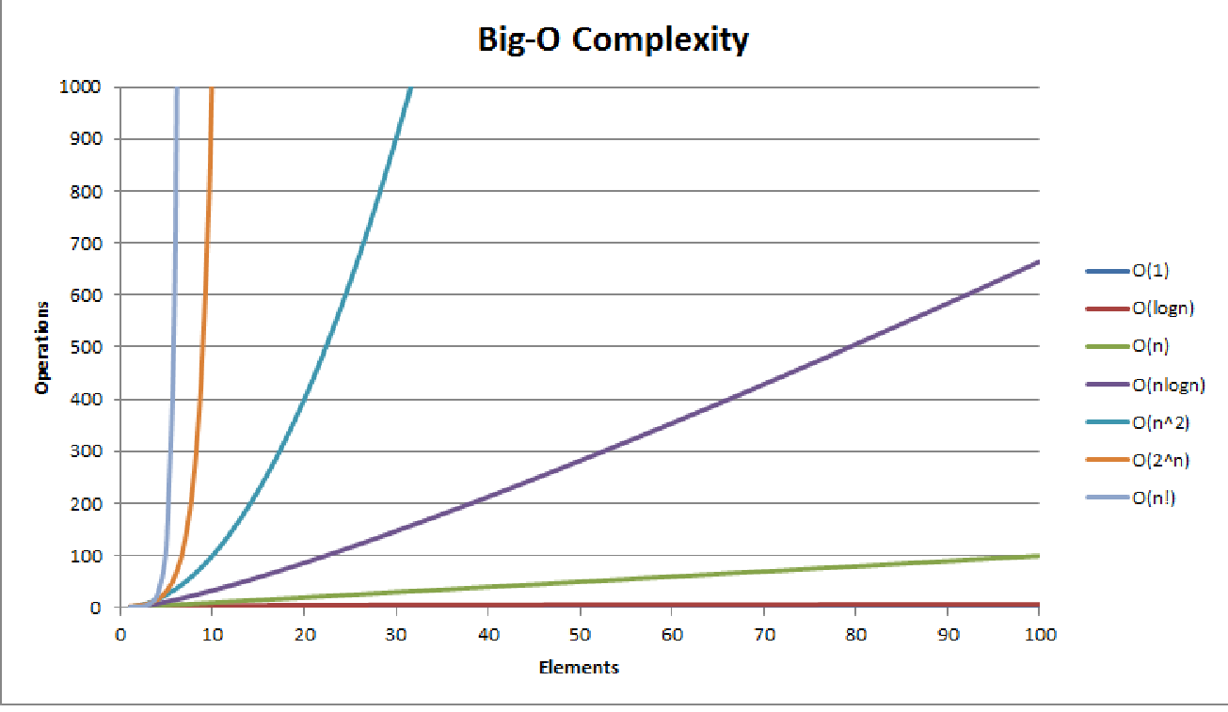
Why is it the best?
It’s efficiency on average is O(n log n)
The O(n log n) Sweet
Spot
Doesn’t require more memory (in place)

Slide 21
QUICK SORT
Three steps
Find pivot that divides the array into two halves.
Quick sort the left half.
Quick sort the right half.

Slide 22
Quick Sort
Divide: Partition the array into two sub-arrays
A[p . . q-1] and A[q+1 . . r] such that each element of
A[p . . q-1] is less than or equal to A[q], which in turn less than or equal to each element of A[q+1 . . r]

Slide 23
 |  |  |  |  |  |  |  | p
numbers less than p
p
numbers greater than or equal to p

Slide 24
Quick Sort
Conquer: Sort the two sub-arrays A[p . . q-1] and
A[q+1 . . r] by recursive calls to quick sort.

Slide 25
Quick Sort
Combine: Since the sub-arrays are sorted in place, no
work is needed to combine them.

Slide 26
Steps
While (number[i] <= number[pivot] && I < last)
I ++ ;
While (number[j] > data[pivot])
j -- ;
If (i < j)
swap data[i] and data[j]
While (j > i) , go to 1.
Swap data[j] and data[pivot]

Slide 27

QuickSort
Pivot = 9
9
1
8
2
7
number[25] = [9,1,8,2,7]

Slide 28


QuickSort
9
1
8
2
7
i
j
Pivot = 9

Slide 29
QuickSort
Step:1 : while( number[i] < = number[pivot] && I <last)
9
1
8
2
7
i
j
Pivot = 9

Slide 30
QuickSort
9 > = 9 ??
9
1
8
2
7
i
j
Pivot = 9

Slide 31
QuickSort
9 > = 9 ??
9
1
8
2
7
i
j
Pivot = 9
True

Slide 32
QuickSort
I ++
9
1
8
2
7
i
j
Pivot = 9

Slide 33
QuickSort
1 < = 9 ??
9
1
8
2
7
i
j
Pivot = 9
Step:1 : while( number[i] < = number[pivot] && I <last)

Slide 34
QuickSort
1 < = 9 ??
9
1
8
2
7
i
j
Pivot = 9
True

Slide 35
QuickSort
I ++
9
1
8
2
7
i
j
Pivot = 9

Slide 36
QuickSort
8 < = 9 ??
9
1
8
2
7
i
j
Pivot = 9
Step:1 : while( number[i] < = number[pivot] && I <last)

Slide 37
QuickSort
8 < = 9 ??
9
1
8
2
7
i
j
True
Pivot = 9

Slide 38
QuickSort
I ++
9
1
8
2
7
i
j
Pivot = 9

Slide 39
QuickSort
2 < = 9 ??
9
1
8
2
7
i
j
Pivot = 9
Step:1 : while( number[i] < = number[pivot] && I <last)

Slide 40
QuickSort
2 < = 9 ??
9
1
8
2
7
i
j
Pivot = 9
True

Slide 41
QuickSort
Step:1 : while( number[i] < = number[pivot] && I <last)
9
1
8
2
7
i
j
7 < = 9 ??
Pivot = 9

Slide 42
QuickSort
Step:1 : while( number[i] < = number[pivot] && I <last)
9
1
8
2
7
i
j
7 < = 9 ??
True
Pivot = 9
But
i = last

Slide 43
QuickSort
Step:1 : while( number[i] < = number[pivot] && I <last)
9
1
8
2
7
i
j
Step 1 fails
Pivot = 9

Slide 44
QuickSort
Step:2 : while( number [ j ] > number [pivot] )
9
1
8
2
7
i
j
Step 1 fails
Pivot = 9

Slide 45
QuickSort
Step:2 : while( number [ j ] > number [pivot] )
9
1
8
2
7
i
j
7 > 9 ??
Pivot = 9

Slide 46
QuickSort
7 > 9 ??
9
1
8
2
7
i
j
False
Pivot = 9
Step 2 fails

Slide 47
QuickSort
7 > 9 ??
9
1
8
2
7
i
j
False
Pivot = 9
Step 2 fails

Slide 48
QuickSort
Step 3: if ( I < j )
9
1
8
2
7
i
j
Pivot = 9
FALSE – NO SWAP

Slide 49
QuickSort
Step 4: while ( I < j )
9
1
8
2
7
i
j
FALSE – 1 st partition over
Pivot = 9

Slide 50
QuickSort
Step 5: swap number[j] and number[pivot]
9
1
8
2
7
i
j
Pivot = 9

Slide 51
QuickSort
Step 5: swap number[j] and number[pivot]
9
1
8
2
7
i
j
Swap 9 and 7
Pivot = 9

Slide 52
QuickSort
Quicksort ( number , 0 , j-1 )
Quicksort (number , j+1 , last )
7
1
8
2
9
i
j
End of partition 1 – Pivot element is fixed
Pivot = 9

Slide 53
QuickSort
n[0]
n[1]
n[2]
n[3]
n[4]
7
1
8
2
9
Pivot = 9

Slide 54
QuickSort
n[0]
n[1]
n[2]
n[3]
n[4]
7
1
8
2
9
numbers less than p
Pivot = 9

Slide 55
QuickSort
Now we sort numbers less than p
7
1
8
2
9
Pivot = 9

Slide 56
QuickSort
Step:1 : while( number[i] < = number[pivot] && I <last)
7
1
8
2
I
J
7 < = 7 ??
9
Pivot = 7

Slide 57
QuickSort
7 < = 7 ??
7
1
8
2
I
J
TRUE
9
Pivot = 7

Slide 58
QuickSort
I ++
7
1
8
2
I
J
9
Pivot = 7

Slide 59
QuickSort
Step:1 : while( number[i] < = number[pivot] && I <last)
7
1
8
2
I
J
1 < = 7 ??
9
Pivot = 7

Slide 60
QuickSort
1 < = 7 ??
7
1
8
2
I
J
TRUE
9
Pivot = 7

Slide 61
QuickSort
I ++
7
1
8
2
I
J
9
Pivot = 7

Slide 62
QuickSort
Step:1 : while( number[i] < = number[pivot] && I <last)
7
1
8
2
I
J
8 < = 7 ??
9
Pivot = 7

Slide 63
QuickSort
8 < = 7 ??
7
1
8
2
I
J
FALSE
9
Pivot = 7

Slide 64
QuickSort
Step:1 : while( number[i] < = number[pivot] && I <last)
8 < = 7 ??
FALSE
7
1
8
2
I
J
STEP 1 FAILS
9
Pivot = 7

Slide 65
QuickSort
Step:2 : while( number [ j ] > number [pivot] )
7
1
8
2
I
J
2 > = 7 ??
9
Pivot = 7

Slide 66
QuickSort
2 > = 7 ??
FALSE
7
1
8
2
I
J
STEP 2 FAILS
9
Pivot = 7

Slide 67
QuickSort
STEP 3 : IF ( J > I ) - SWAP number[i] and number[j]
7
1
8
2
I
J
TRUE - SWAP
9
Pivot = 7

Slide 68
QuickSort
7
1
8
2
I
J
9
Pivot = 7

Slide 69
QuickSort
Step 4: while ( I < j ) - GO TO STEP 1
7
1
2
8
I
J
TRUE – GO TO STEP 1
9
Pivot = 7

Slide 70
QuickSort
Step:1 : while( number[i] < = number[pivot] && I <last)
7
1
2
8
I
J
2 < = 7 ??
9
Pivot = 7

Slide 71
QuickSort
Step:1 : while( number[i] < = number[pivot] && I <last)
7
1
2
8
I
J
2 < = 7 ??
TRUE
9
Pivot = 7

Slide 72
QuickSort
I ++
7
1
2
8
I
J
9
Pivot = 7

Slide 73
QuickSort
Step:1 : while( number[i] < = number[pivot] && I <last)
7
1
2
8
I
J
8 < = 7 ??
9
Pivot = 7

Slide 74
QuickSort
8 < = 7 ??
FALSE
7
1
2
8
I
J
STEP 1 FAILS
9
Pivot = 7

Slide 75
QuickSort
Step:2 : while( number [ j ] > number [pivot] )
7
1
2
8
I
J
8 > = 7 ??
9
Pivot = 7

Slide 76
QuickSort
8 > = 7 ??
TRUE
7
1
2
8
I
J
9
Pivot = 7

Slide 77
QuickSort
J --
7
1
2
8
J
I
9
Pivot = 7

Slide 78
QuickSort
Step:2 : while( number [ j ] > number [pivot] )
7
1
2
8
J
I
2 > = 7 ??
9
Pivot = 7

Slide 79
QuickSort
2 > = 7 ??
FALSE
7
1
2
8
J
I
STEP 2 FAILS
9
Pivot = 7

Slide 80
QuickSort
STEP 3 : IF ( J > I ) - SWAP number[i] and number[j]
7
1
2
8
J
I
FALSE – NO SWAP
9
Pivot = 7

Slide 81
QuickSort
Step 4: while ( I < j ) - GO TO STEP 1
7
1
2
8
J
I
FALSE - PARTITION 2 OVER
9
Pivot = 7

Slide 82
QuickSort
Step 4: while ( I < j ) - GO TO STEP 1
7
1
2
8
J
I
FALSE - PARTITION 2 OVER
9
Pivot = 7

Slide 83
QuickSort
Step 4: while ( I < j ) - GO TO STEP 1
7
1
2
8
J
I
9
Pivot = 7

Slide 84
QuickSort
Step 5: swap number[j] and number[pivot]
7
1
2
8
J
I
9
Pivot = 7

Slide 85
QuickSort
Step 5: swap number[j] and number[pivot]
2
1
7
8
J
I
END OF PARTITION – PIVOT IS FIXED
9
Pivot = 7

Slide 86
QuickSort
2
1
7
8
P
LESSER THAN P
GREATER THAN P
9
Pivot = 7

Slide 87
QuickSort
8
I J
2
1
7
9
Pivot = 8

Slide 88
QuickSort
SORTING THE ELEMENTS LESSER THAN THE PIVOT
2
1
7
8
9
Pivot = 2

Slide 89
QuickSort
Step:1 : while( number[i] < = number[pivot] && I <last)
SORTING THE ELEMENTS LESSER THAN THE PIVOT
2
1
I
J
2 < = 2 ??
7
8
9
Pivot = 2

Slide 90
QuickSort
Step:1 : while( number[i] < = number[pivot] && I <last)
2 < = 2 ??
2
1
I
J
TRUE
7
8
9
Pivot = 2

Slide 91
QuickSort
I ++
2
1
I
J
7
8
9
Pivot = 2

Slide 92
QuickSort
Step:1 : while( number[i] < = number[pivot] && I <last)
2
1
I
J
STEP 1 FAILS
7
8
9
Pivot = 2

Slide 93
QuickSort
Step:2 : while( number [ j ] > number [pivot] )
2
1
I
J
STEP 2 FAILS
7
8
9
Pivot = 2

Slide 94
QuickSort
STEP 3 : IF ( J > I ) - SWAP number[i] and number[j]
2
1
I
J
STEP 3 FAILS
7
8
9
Pivot = 2

Slide 95
QuickSort
Step 4: while ( I < j ) - GO TO STEP 1
2
1
I
J
STEP 4 FAILS
7
8
9
Pivot = 2

Slide 96
QuickSort
Step 5: swap number[j] and number[pivot]
2
1
I
J
7
8
9
Pivot = 2

Slide 97
QuickSort
Step 5: swap number[j] and number[pivot]
1
2
I
J
7
8
9
Pivot = 2

Slide 98
QuickSort
Step 5: swap number[j] and number[pivot]
1
I
J
2
7
8
9
Pivot = 1

Slide 99
QuickSort
a[0]
a[1]
a[2]
a[3]
a[4]
13
28
35
41
57
SORTED LIST

Slide 100
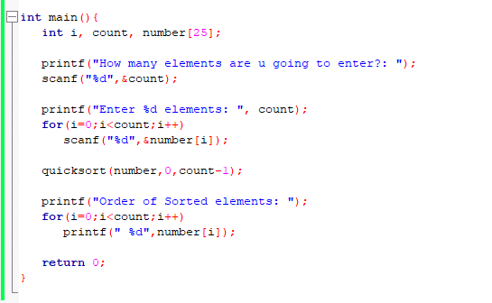

Slide 101
INPUT
PROCESS
OUTPUT

Slide 102
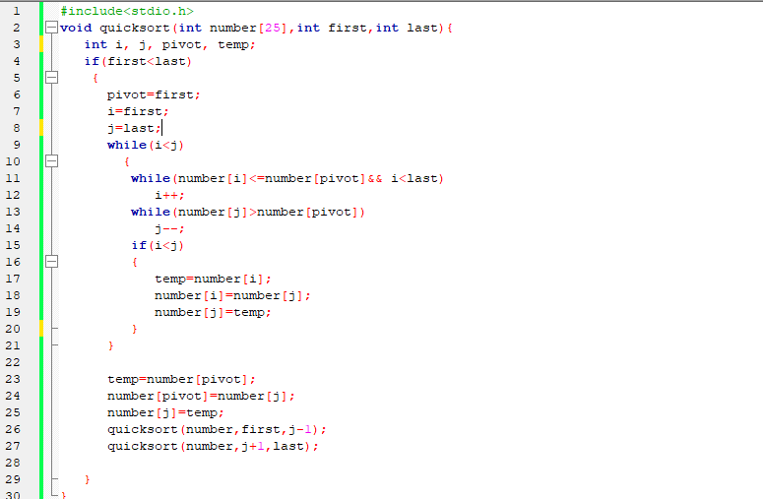

Slide 103
STEP 4
STEP 1
STEP 2
STEP 3
STEP 5

Slide 104
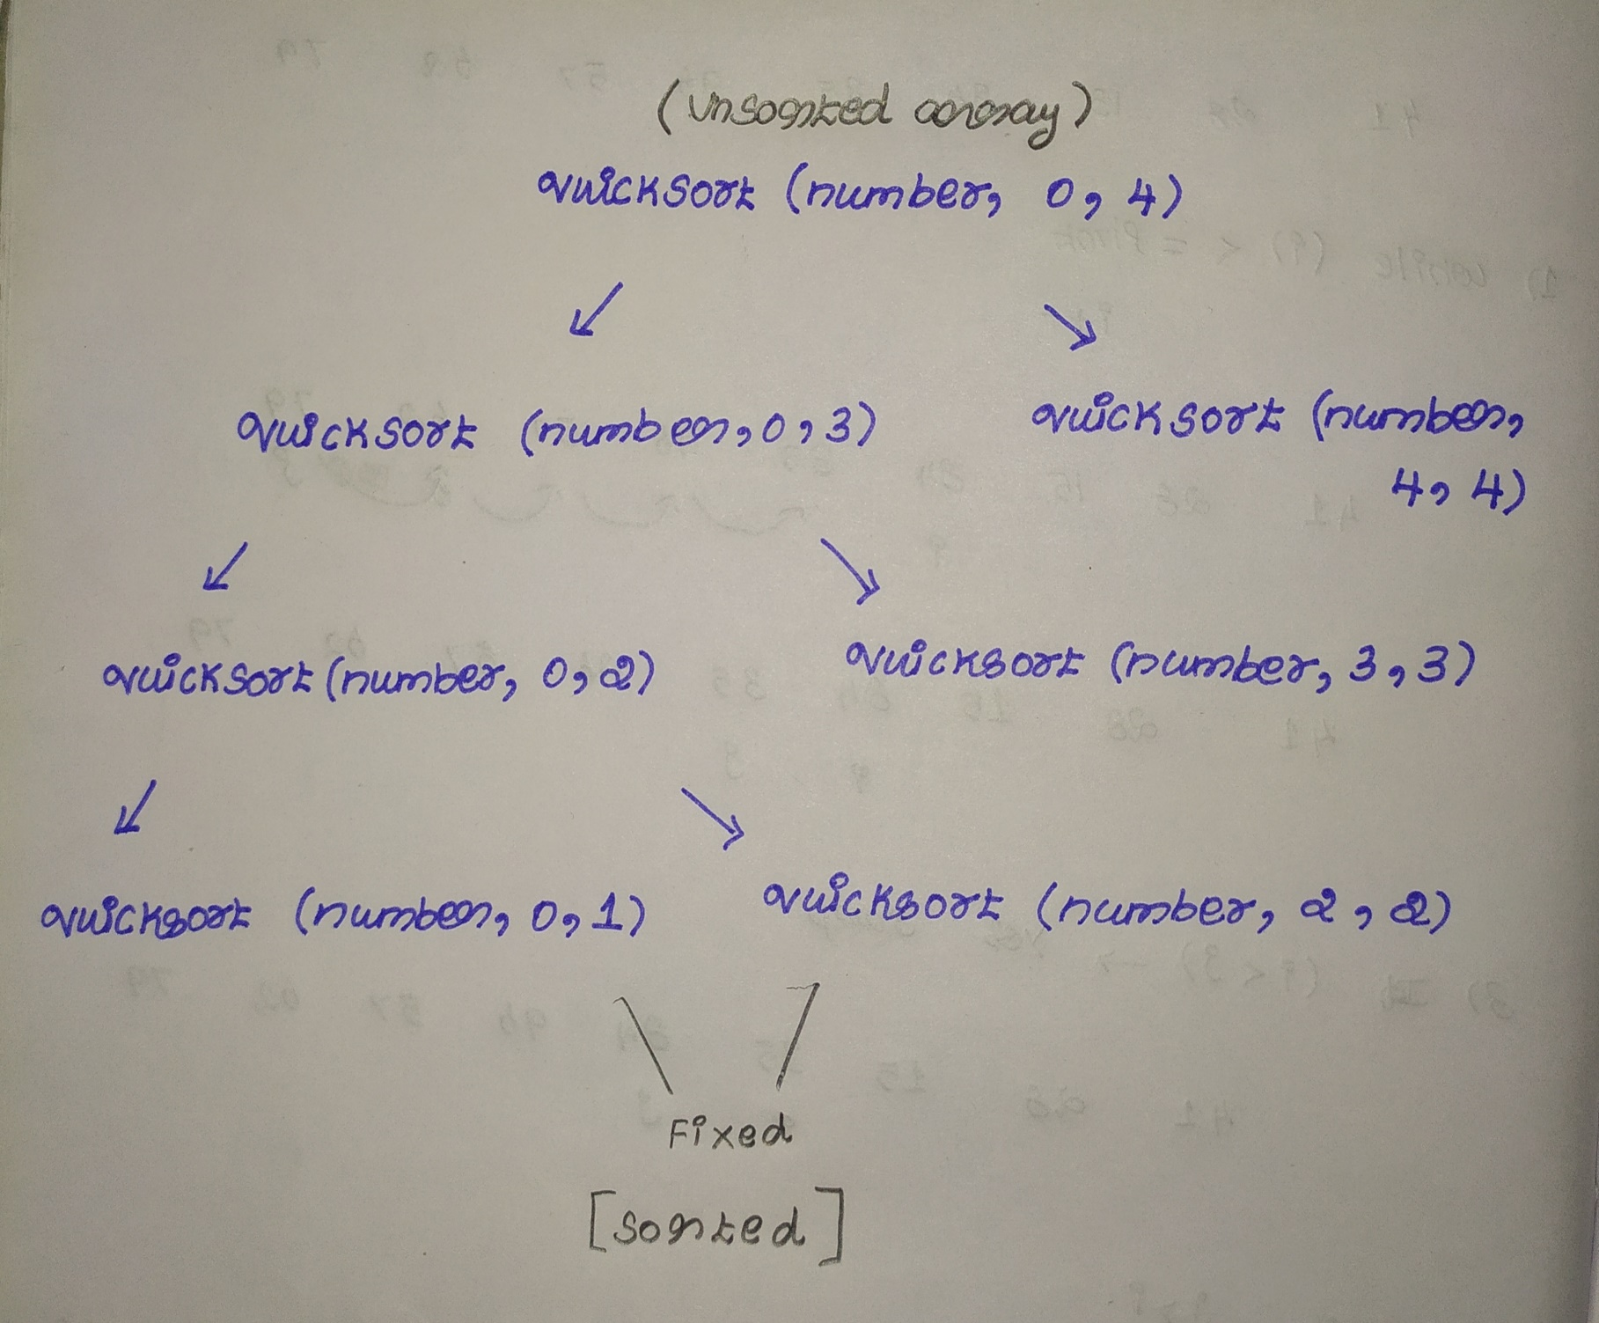

Slide 105
QuickSort
SORTING THE ELEMENTS LESSER THAN THE PIVOT
2
1
7
8
9
Pivot = 2

Slide 106
QuickSort
Step:1 : while( number[i] < = number[pivot] && I <last)
2
1
I
J
STEP 1 FAILS
7
8
9
Pivot = 2

Slide 107
QuickSort
Step:2 : while( number [ j ] > number [pivot] )
2
1
I
J
STEP 2 FAILS
7
8
9
Pivot = 2

Slide 108
QuickSort
STEP 3 : IF ( J > I ) - SWAP number[i] and number[j]
2
1
I
J
STEP 3 FAILS
7
8
9
Pivot = 2

Slide 109
QuickSort
Step 4: while ( I < j ) - GO TO STEP 1
2
1
I
J
STEP 4 FAILS
7
8
9
Pivot = 2

Slide 110
QuickSort
Step 5: swap number[j] and number[pivot]
1
2
I
J
7
8
9
Pivot = 2

Slide 111
QuickSort
a[0]
a[1]
a[2]
a[3]
a[4]
13
28
35
41
57
SORTED LIST

